Slide 1
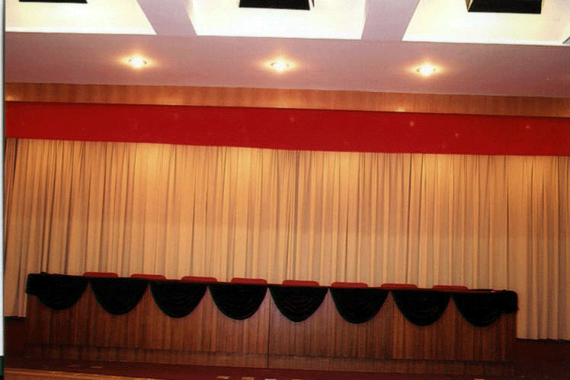
Economic Final Review

Slide 2
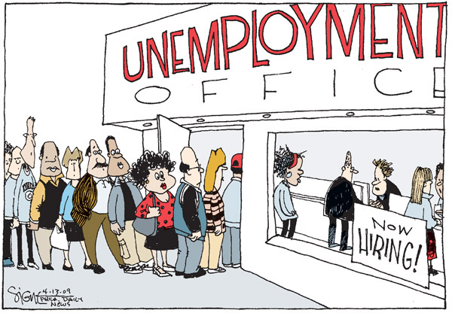
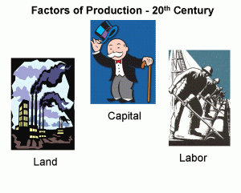
What is Microeconomics ?
Study of small or individuals economic units
What is Macroeconomics?
Study of the national economy (inflation, unemployment, wage, GDP)
What are the three basic economic questions ?
What to produce, how to produce, for whom to produce
Define the four factors of production
Land-natural resources Capital- tools to make other goods
Labor- people working Entrepreneurship- risk takers in search for profit
What is opportunity cost?
Cost of the next best alternative given up when making a choice (trade-off)
How are opportunity cost and tradeoffs related?
An opportunity cost is incurred when a trade off is made

Slide 3
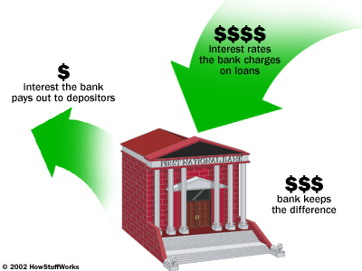
What is scarcity?
Limited resources, unlimited needs and wants
What is conspicuous consumption
Spending money to impress others (showing off)
What does the production possibilities frontier represent?
Trade-offs, opportunity cost, full use of resources
What is principal?
The amount borrowed in a loan
What is interest ?
Cost of borrow, price to use another person’s money
What is a share holder
Owner of stock in a corporation, common stock – voting rights
What is a non profit organization?
Community services organization, churches, schools

Slide 4
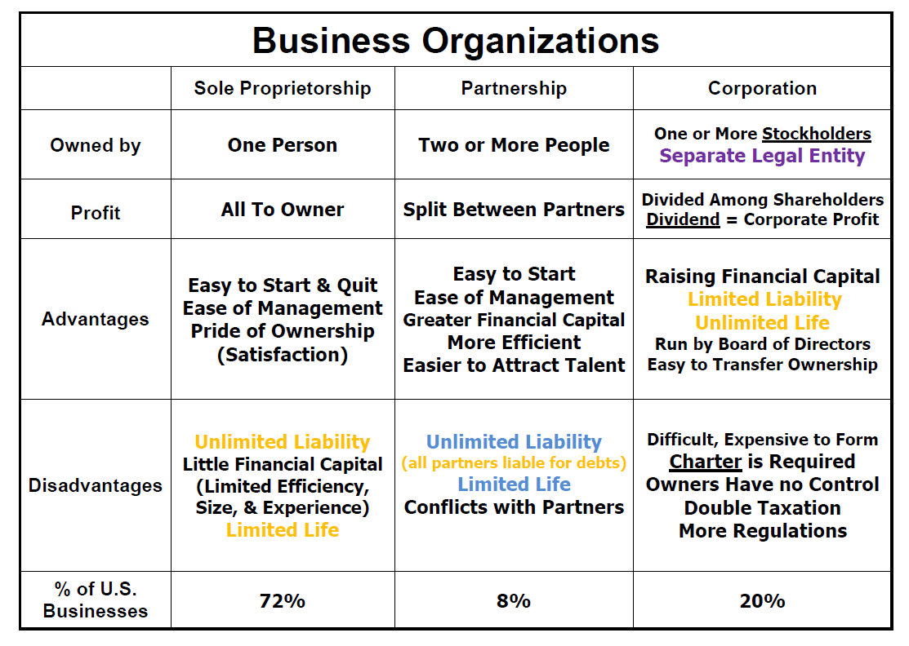
What is a sole proprietorship, corporation, and partnership?
What does the securities and exchange commission do?
Regulates sale of corporation stock to the public

Slide 5
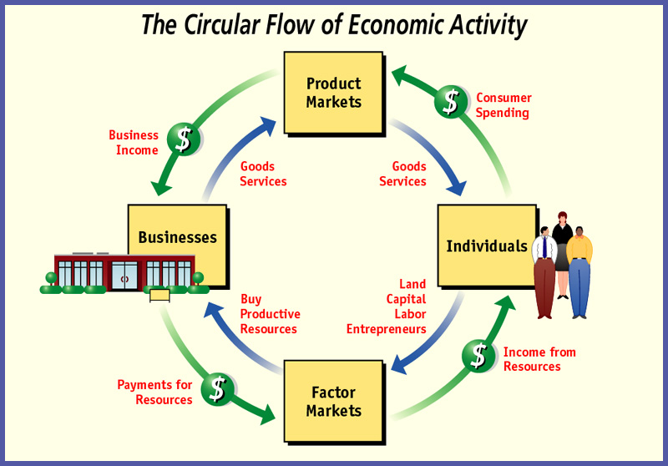
What is a vertical merger?
Merger of different steps of manufacturing
What is a horizontal merger?
Merger of the same type of business
What is a conglomerate?
One firm owning many different or unrelated business, diversification a major reason
Describe the circular flow of income >>>>>

Slide 6
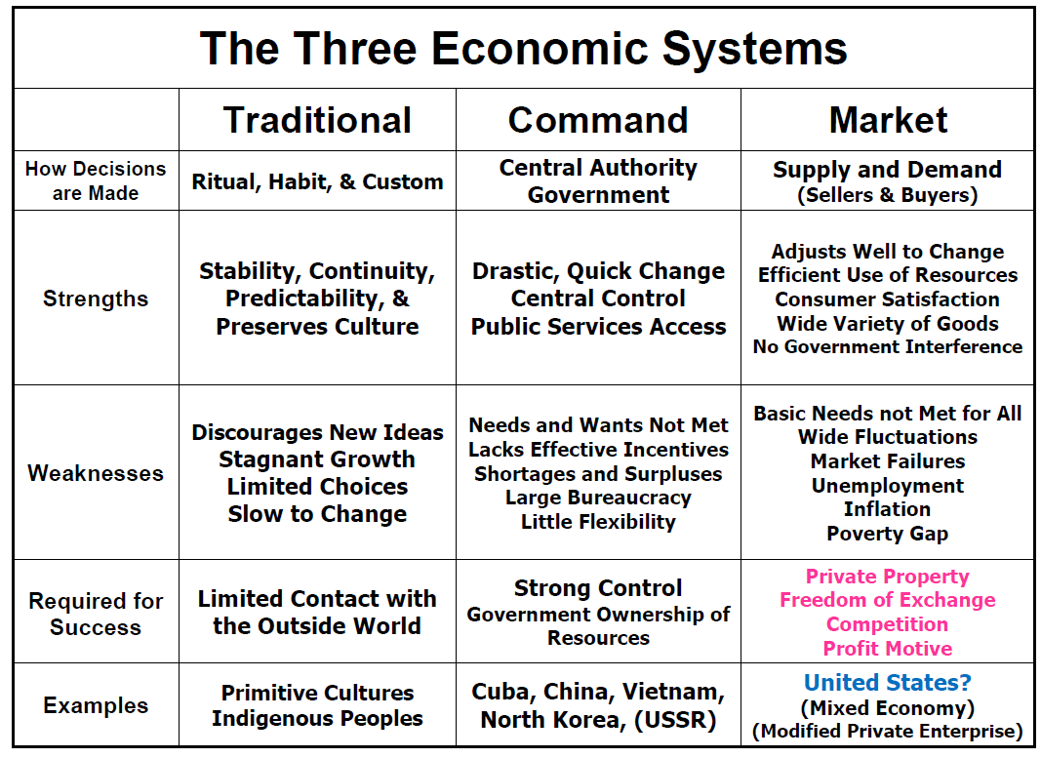
What is a traditional, command, and market economy?
What is a mixed economy?
Combination of command and market (Ex. USA)

Slide 7
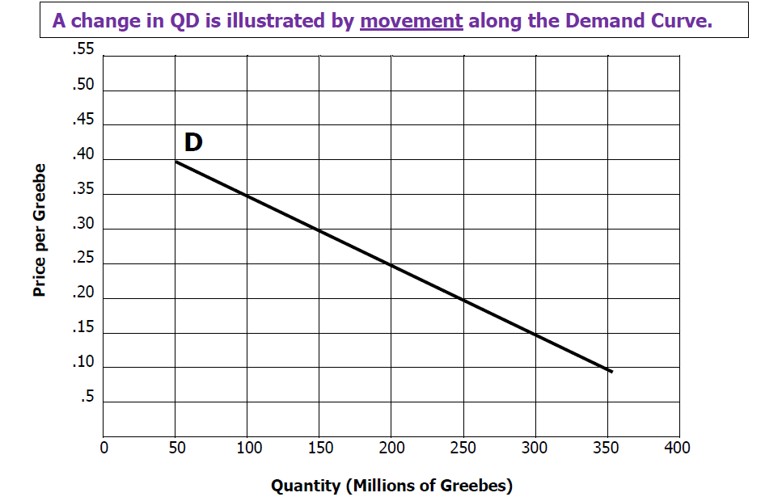
What is the demand curve?
Downward sloping curve to the right
What is diminishing marginal utility?
As buyer consumer more, consumers receive
less additional satisfaction
What are complements ?
The use of one product lead to the use of another product. (Ex: DVDs, and DVD player, cameras and films, cereal, and milk.)
a) If camera prices rise, demand for film decreases
What are substitutes ?
Products that can be used in place of other products (Ex: Butter and margarine, beef and chicken)
a) If butter prices rise, demand for margarine increases.

Slide 8
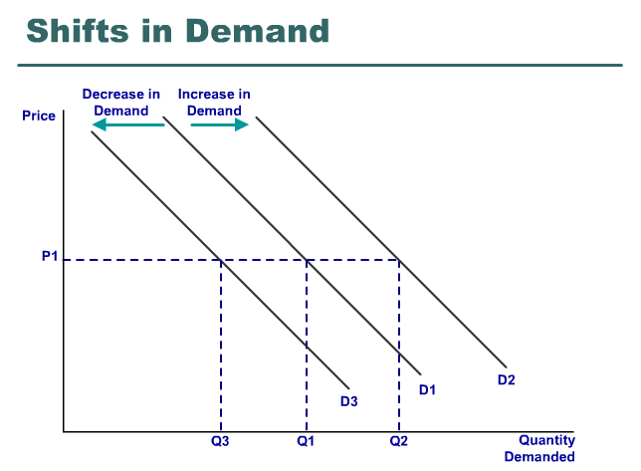
What is change in quantity demanded?
A movement along the demand curve caused by a change in price
What is a change in demand? What happens to the demand curve?
People willing to buy different amounts of the product at the same prices.
Shift to Right = increase, Shift to left = decrease
What is the law of demand? Relationship between price and quantity demanded.
Price increases, quantity demanded decreases (inverse)

Slide 9
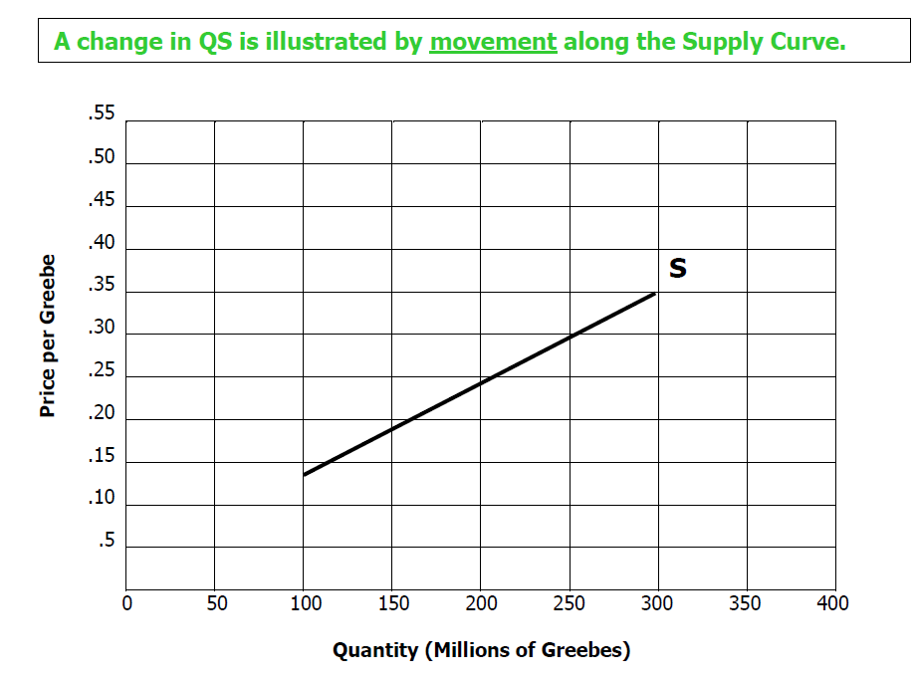
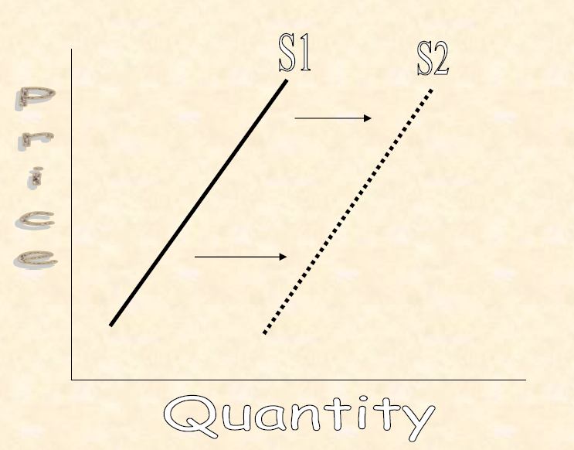
What is the supply curve?
Upward sloping curve to the right
What is the law of supply? relationship between price and quantity demanded.
As price increase, quantity supplied increase (direct)
What is a change in quantity supplied?
Movement along the supply curve
What is a change in supply ? What to happens to the supply curve
Shift to right or to the left

Slide 10
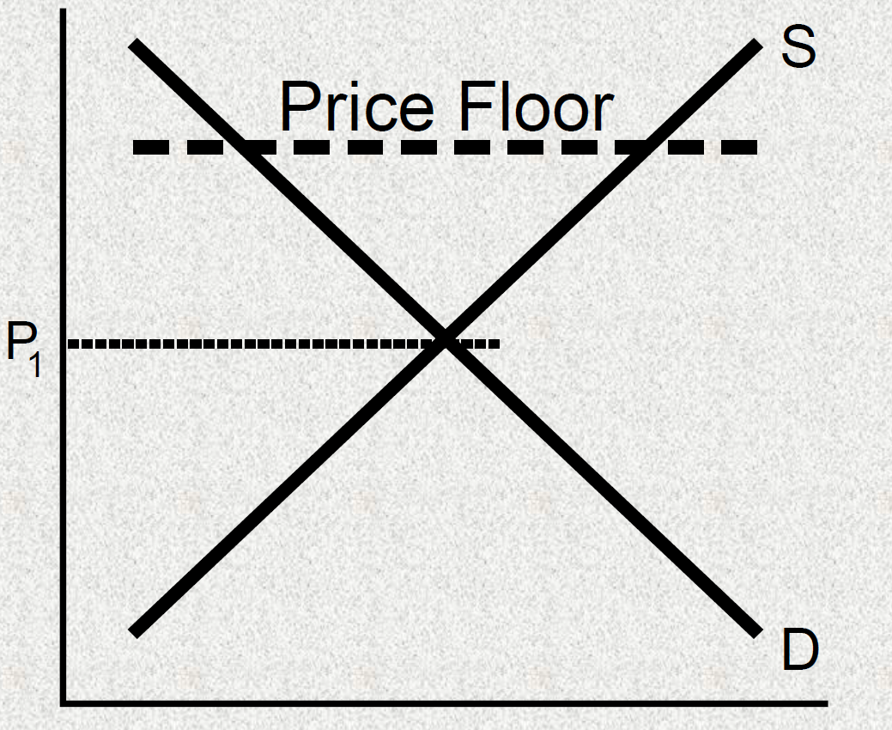
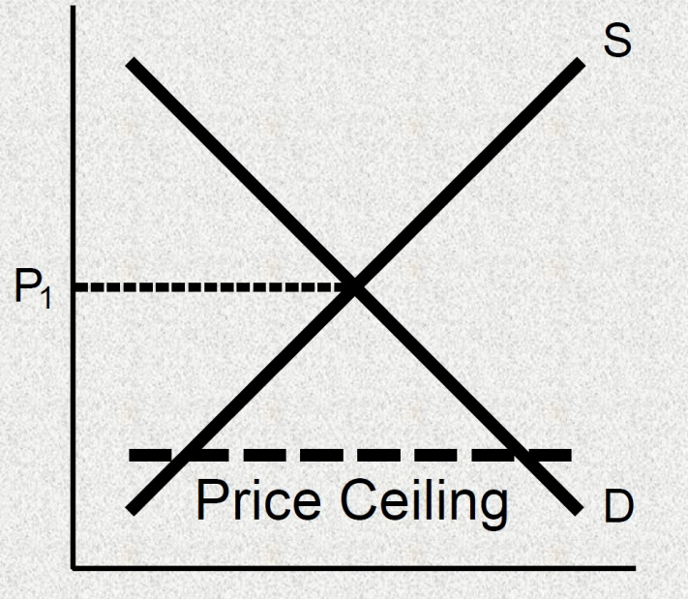
What is a surplus? What happens to prices when there is a surplus?
QS> QD, price above equilibrium (price goes down)
What is a shortage? What happens to prices when there is a shortage.
QD> QS, price below equilibrium (prices goes up)
What is market equilibrium?
a) what happens if there is an increase in demand
b) what happens if there is a decrease in demand
c) what happens if there is an increase in supply
d) what happens if there is a decrease in supply
QS=QD
Shortage; price goes up
Surplus; price goes down
Price goes down
Price goes up

Slide 11
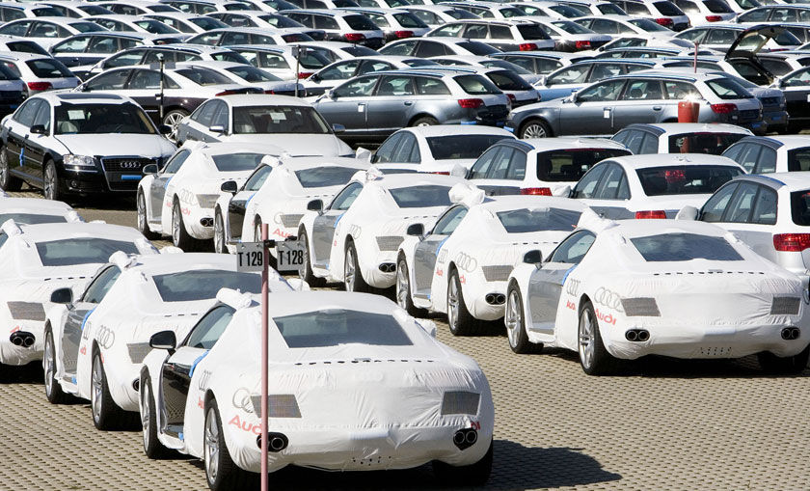
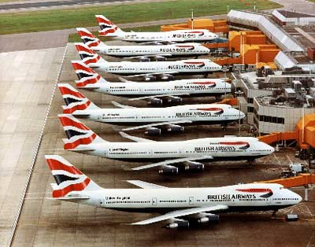
What is pure(perfect) competition?
A large number of well informed independent buyers and sellers who exchange identical products.
What is imperfect competition?
Lack one or more of the conditions of perfect competition
What is a monopoly?
Only one seller of a particular product, extensive influence over price, almost impossible to enter the market
What is an oligopoly?
Has few number of firms in the industry, some influence over price fair amount of product differentiation, and advertising, but difficult to enter the market

Slide 12
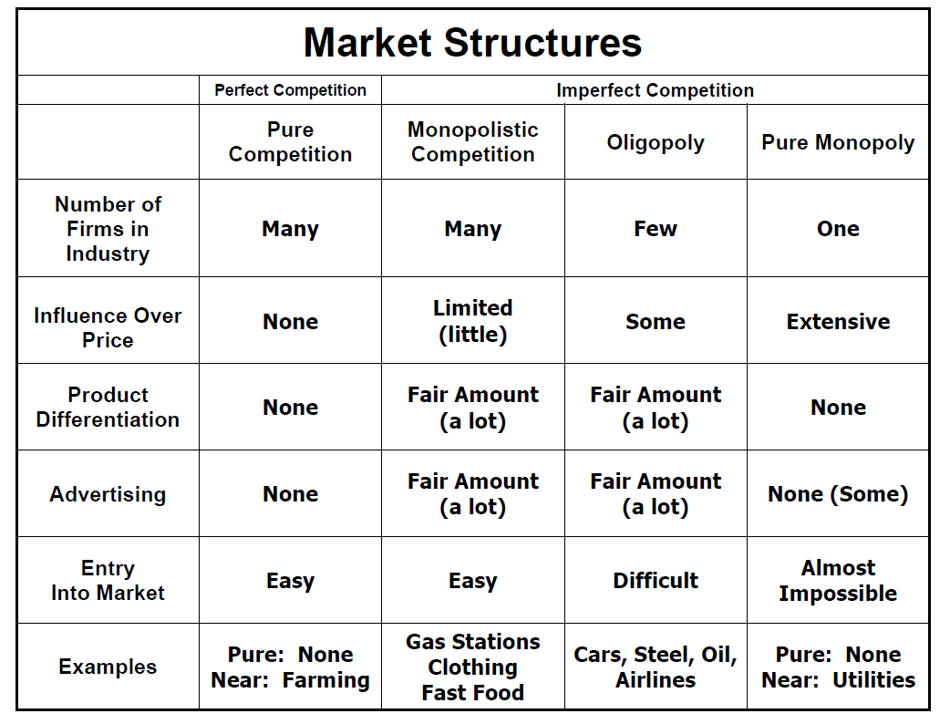

Slide 13
What is a monopolistic competition?
Has many firms in industry, limited influence over price, and fair amount of product differentiation, and advertising, but is easy to enter into the market
What is a natural monopoly?
Example: Public utilities
What is a technological monopoly
Created by patent or copyright
What is a geographic monopoly
Absence of other sellers in a certain geographic area.
(Ex: only gas station in town)
What is a government monopoly
Government owns and operates (Ex: water use, military weapons)

Slide 14
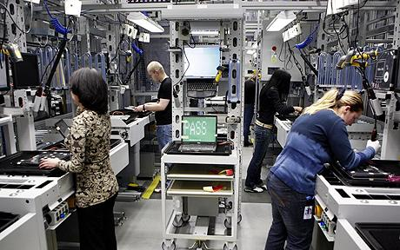
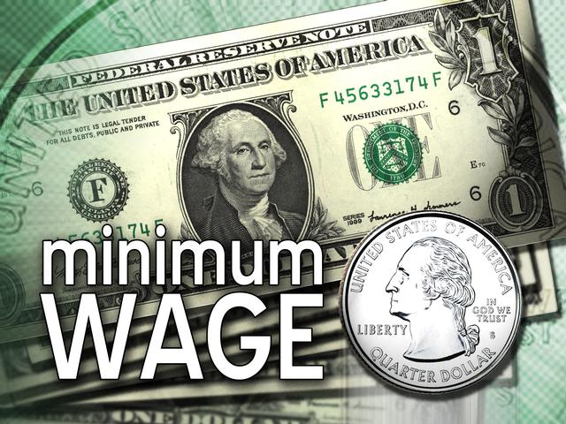
What is the Sherman Anti-Trust Act
The 1st Anti-Monopoly law – outlawed restraint against trade
What is the Clayton Act?
Anti monopoly law, outlawed price discrimination
What type of worker commonly joins labor unions ?
People in manufacturing jobs and public services professions
What is negotiated in collective bargaining?
Wages, health benefits, vacations, and working hours

Slide 15
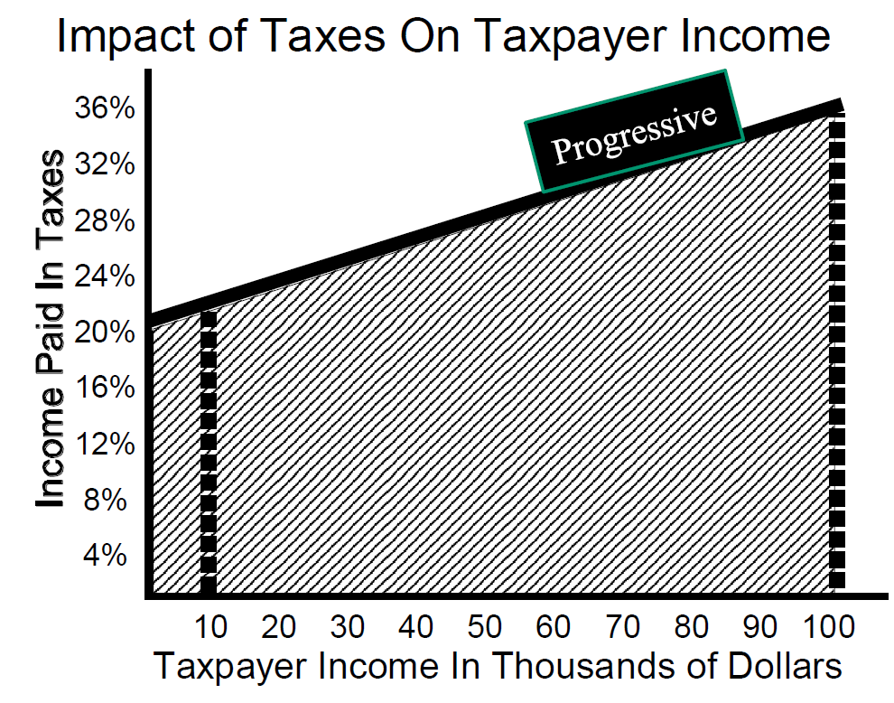
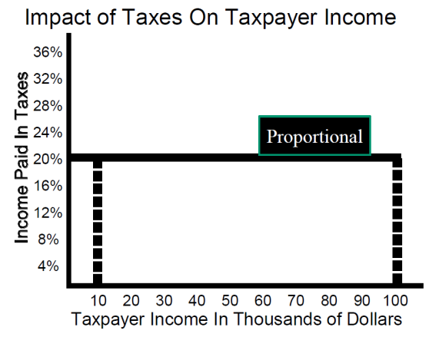
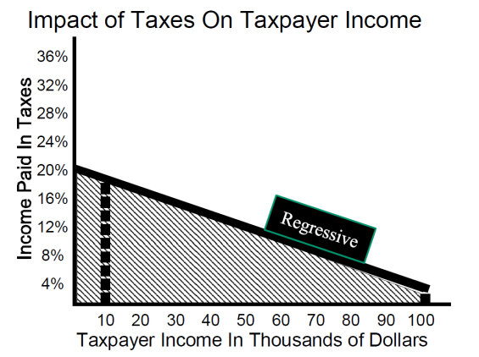
What are the top three federal expenditures?
Social Security/Medicare, national defense, interest on the debt
What are the three biggest sources of revenue for the federal government?
Individual income tax, FICA(social security/ Medicare) Tax, corporate income tax
What is a progressive tax
Low tax % on low income,
higher tax % on higher income tax
What is the proportional tax
Flat tax; same percentage on all incomes
What is a regressive tax
Higher tax on burden on lower incomes. Ex: sales tax

Slide 16
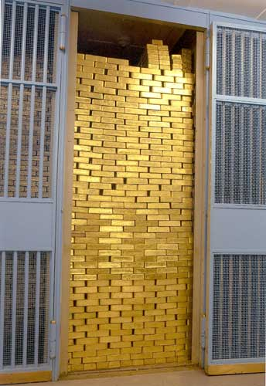
What is the federal reserve system (the fed)
Nation’s central bank
What are banks required do?
Maintain legal reserves (keep some money in the bank)
What is an easy money policy?
a. How does the fed increase the money supply?
Expand, increases growth of money supply
a. Lower interest rates (unemployment/recession)
What is a tight money policy
a. how the Fed decrease the money supply
Contracts, decreases growth of money supply
a. Raise interest rates (inflation)
What is the goal of monetary policy?
Economic growth without causing inflation

Slide 17
What are reserve requirements ?
Percentage of deposits on reserve (vault cash or in federal reserve bank account)
What is the discount rate?
Interest rate Fed charge banks
What are open market operations?
Buying & selling government securities
What is demand pull inflation?
Caused by consumers
What is cost-push inflation
Caused by businesses

Slide 18
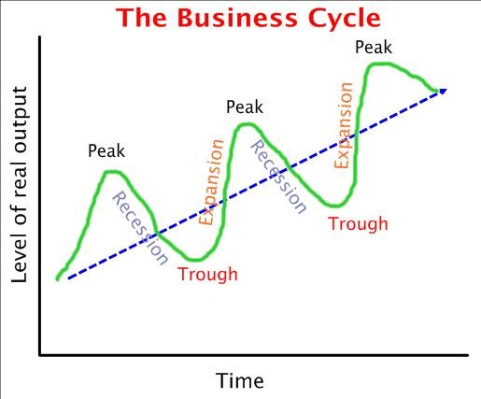
What are the consequences of inflation?
Decline in purchasing power, people spend less
What is unemployment?
People who are out of work
What are fiscal policies to fight unemployment?
Increase Government spending, decrease taxes

Slide 19
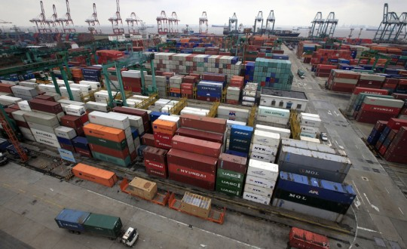
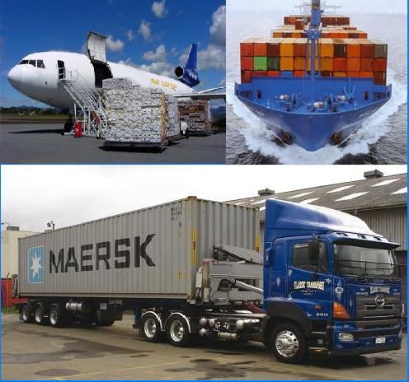
What does the Fed (monetary Policy) do to fight unemployment
Reduce discount/interest rate, cut reserve requirement
What is an export
Products sent to other country
What is an import
Products bought into the country
What is a trade surplus
Exports are greater than > imports
What is a trade deficit
Import are greater than > exports

Slide 20
What is an embargo
Refusal to import or export from or to another country
What is a comparative advantage
When a country produces a product more efficiently than another country
What is an absolute advantage
A country can produce more units of product than another country
What is the WTO ( World Trade Organization)
Replaced GATT & advocates free trade & no trade barriers
What is NAFTA (North American Free Trade Agreement)
Canada, USA, Mexico

Slide 21
What is a tariff
Tax on imports
What is a quota
a) what are the consequence of high tariffs and low quotas?
b) what are the consequences of low tariffs and high quotas
Limit on number of imports
a) protectionism, help save domestic jobs
b) free trade
What is the difference between a revenue tariff and a protective tariff?
Revenue: raise money, protective: protect specific industry
What is an infant industry
Business just starting

Slide 22
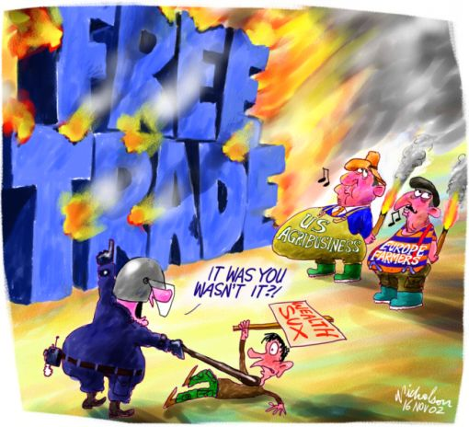
What is a protectionist?
a. what type of tariffs and quotas does a protectionist favor?
b. who do they want to help?
High tariffs and low quotas
Protect domestic jobs & infant industries
What is a free trader?
a. what type of tariffs and quotas does a free trader favor?
b. who do they want to help
Low tariffs and high quotas
Stronger businesses who will survive/no protection of weak bus.

