Slide 1
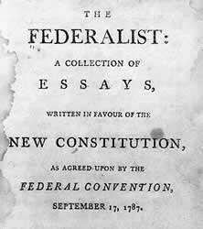
Federalist #10

Slide 2
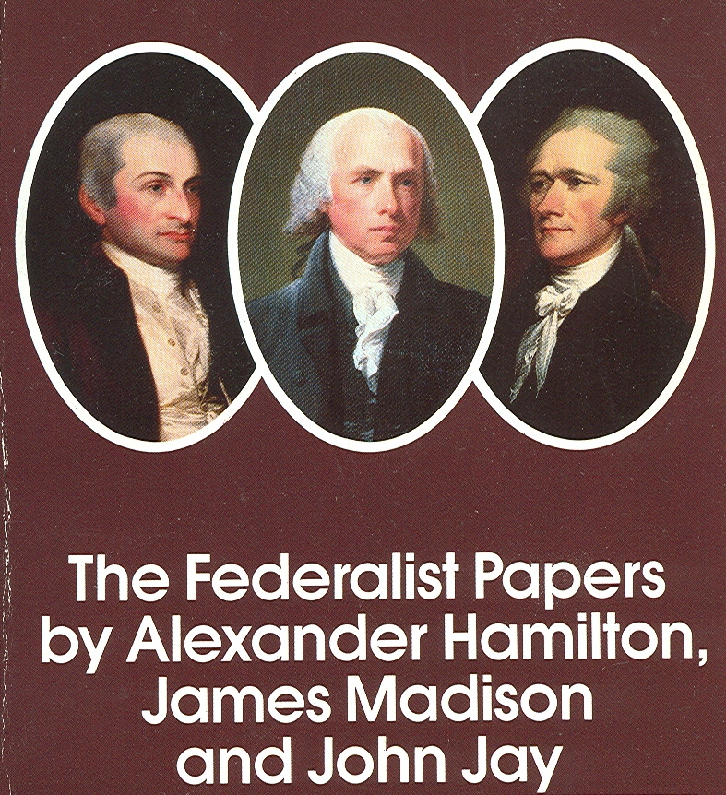
The Federalist Papers
Written in 1787 by James Madison, John Jay, and Alexander Hamilton under the penname of Publius
Their purpose was to advocate the ratification of the new constitution by the states
They are an authoritative but unofficial explanation of American government by those who created it

Slide 3
Federalist #10
Madison wrote Federalist #10 to counter the argument that democracies inevitably dissolve into turmoil and disorder caused by factions which ignore the national interest in favor of their own interests.
The consensus of late 19th century political thought was that a monarchy was needed to restrain the destructive tendency of faction.
Today, the opponents of democracy make similar arguments in behalf of undemocratic forms of government.

Slide 4
WHAT IS A FACTION?
A number of citizens, either a minority or a majority that are united by a common impulse or passion adverse to the rights of other citizens or the best interests of the community.

Slide 5
WHAT CAUSES FACTION?
Madison says they are “sown in the nature of man”
People have different opinions about religion, government, political leaders . . .
The most common cause of faction is the “various and unequal distribution of property. Those who hold and those who are without property have ever formed distinct interests in society.”

Slide 6
WHY ARE FACTIONS A PROBLEM?
The most powerful faction will control the government and make decisions based not on the common good but to benefit itself.
Other groups and the common good will suffer.

Slide 7
THE DILEMMA OF PURE DEMOCRACY
In a pure democracy, the people assemble and administer the government in person.
Pure democracy can only exist in a small geographical area.
Pure democracies inevitably fall victim to the mischief of faction.
Pure democracies fail because they are unable to protect individual liberty and the rights of property.

Slide 8
WOULD REMOVING THE CAUSES OF FACTION SOLVE THE PROBLEM?
No. Destroying the liberty that allows faction to develop is a cure worse than the disease.
Giving everyone the same opinion is impractical.

Slide 9
CONTROLLING THE EFFECTS OF FACTION
If a faction is less than a majority, then rely on majority rule to control it.
If a faction is in the majority, then rely on the type of political system to control it.
The cure to the problem of factions is a large republic.

Slide 10
A REPUBLIC IS DIFFERENT FROM A PURE DEMOCRACY
In a republic, the citizens elect representatives to make policy decisions and administer the government on their behalf.
A republic can be established in a larger country than can a pure democracy because of its representative nature.

Slide 11
WHAT ARE THE ADVANTAGES OF A LARGE REPUBLIC?
A large republic provides a bigger candidate pool from which to select fit leaders.
A large electorate is less likely to select undesirable leaders than is a small electorate.
A larger territory will include a greater diversity of interests than will a smaller territory.
A majority faction is therefore unlikely to emerge in a large territory.

Slide 12
THE DILEMMA OF DISTRICT SIZE
In a LARGE ELECTORAL DISTRICT, the representative may be too little acquainted with local interests and circumstances to represent them effectively.
In a SMALL ELECTORAL DISTRICT, the representative may be too attached to local issues and unconcerned or unable to comprehend national concerns.

Slide 13
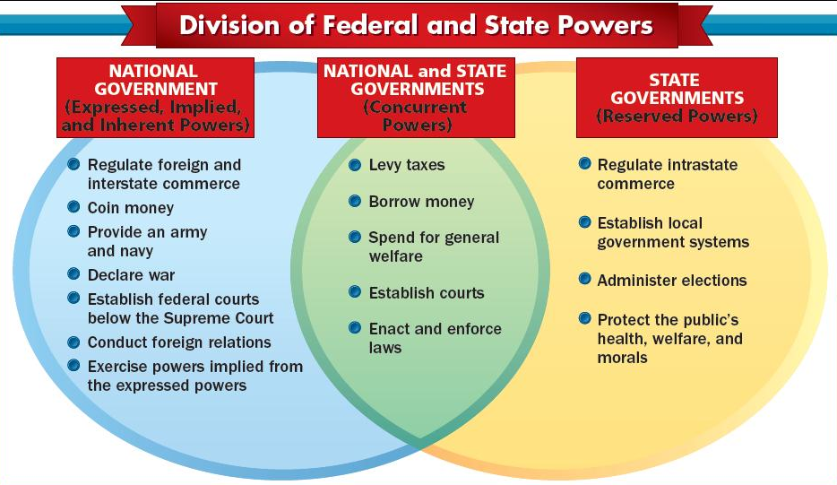
THE FEDERAL SOLUTION
The federal system provides a “happy combination,” as Madison put it. The national government deals with national issues while the state governments address local issues.

Slide 14
SUMMARY
Madison wrote Federalist #10 to defend the Constitution against the charge that a faction would soon gain control, substituting its own interest for the national interest.
The antidote to the problem of faction, Madison declared, is a large republic with a multiplicity of interests, making it unlikely that a majority faction will form.

Slide 15
QUESTIONS AND ANSWERS
According to Madison, what conditions have historically plagued "popular governments?”
Instability, injustice, confusion.
Had the U.S. effectively dealt with those conditions? Explain.
No. There have been “improvements” in the U.S. but there are “complaints” from “virtuous citizens” that the government is unstable, that the public good is disregarded, and that measures are decided by an “overbearing majority.”
What is the most common cause of factions?
The unequal distribution of property, or wealth: property owners vs. non-property owners, creditors vs. debtors, landed wealth vs. manufacturing wealth.

Slide 16
QUESTIONS AND ANSWERS
Is the "republican principle" more effective in controlling the effects of a minority faction or a majority faction? Explain.
It is more effective in controlling the effects of a minority faction because a simple majority vote will thwart the will of a minority. A majority faction, however, may sacrifice both the public good and the rights of citizens through its sheer voting power.
Is a republic or a pure democracy more suitable for controlling the effects of factions? List the differences that Madison cites between the two.
A republic is more suitable than a pure democracy.
A republic delegates the chores of government to a small number of elected citizens.
A republic includes a greater number of citizens and a larger geographical area.
Why is a large republic more likely to control the effects of factions than a small republic?
The larger the number of citizens, the less likely it is that unworthy candidates can get away with the practice of their “vicious arts.”
A large territory would be more likely to have a large number of interests. With such a large number of interests, it is less likely that one interest could monopolize power.

Slide 17
QUESTIONS AND ANSWERS
Does Madison consider factions to be good or bad?
Both. Madison defined a faction as a number of citizens, either a minority or a majority, that are united by a common impulse or passion adverse to the rights of other citizens or the best interests of the community. From the perspective of the common good, which was Madison’s goal, factions are a problem.
Nonetheless, multiple factions play a positive role by counterbalancing one another. Madison’s solution to the problem of faction is a large republic with a multiplicity of factions that keep one another from becoming too powerful. Factions, then, are also the solution.

Slide 18
DISCUSSION QUESTION
How do each of the following constitutional provisions reflect the founders’ bias against pure democracy?
The electoral college
The original process for choosing U.S. senators
The procedure for amending the Constitution
The presidential veto

